Slide 1
Persuasive Presentations
SESSION IV: GROUPS & TEAMS (IN) ACTION

Slide 2
Chapter outlines
What Is Persuasion?
Meeting the Listener’s Basic Needs
Speaking Ethically
Elevator Speech

Slide 3
LEARNING OBJECTIVES
By the end of this section, you will be able to:
Demonstrate an understanding of the importance of persuasion.
Describe similarities and differences between persuasion and motivation.
Identify and describe several basic needs that people seek to fulfill when they communicate.
Demonstrate the importance of ethics as part of the persuasion process.
Discuss the basic parts of an elevator speech.

Slide 4
1. What Is Persuasion?
Persuasion is an act or process of presenting arguments to move, motivate, or change your audience
Persuasion can be implicit or explicit and can have both positive and negative effects.

Slide 5
Reasons for Engaging in Communication
Gain information
Meet our need
Understand communication contexts
Understand our identity

Slide 6
2. Meeting the Listener’s Basic Needs
Getting someone to listen to what you have to say involves a measure of persuasion, and getting that person to act on it might require considerable skill.

Slide 7
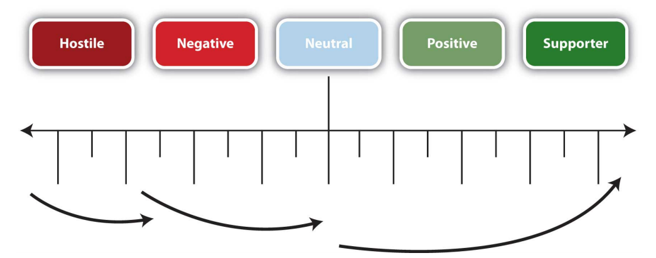
Measurable Gain

Slide 8
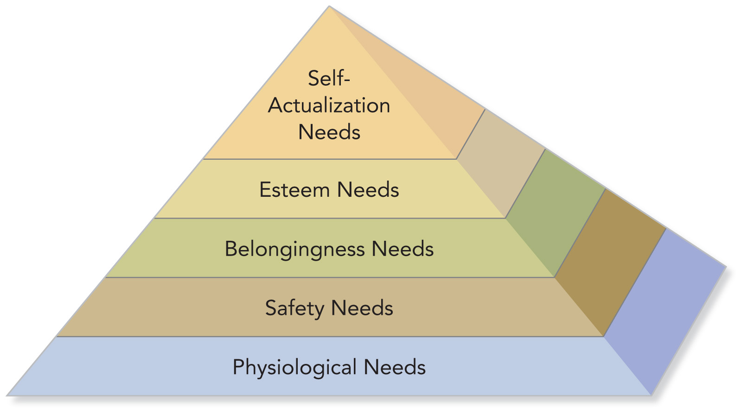
Maslow’s Hierarchy

Slide 9
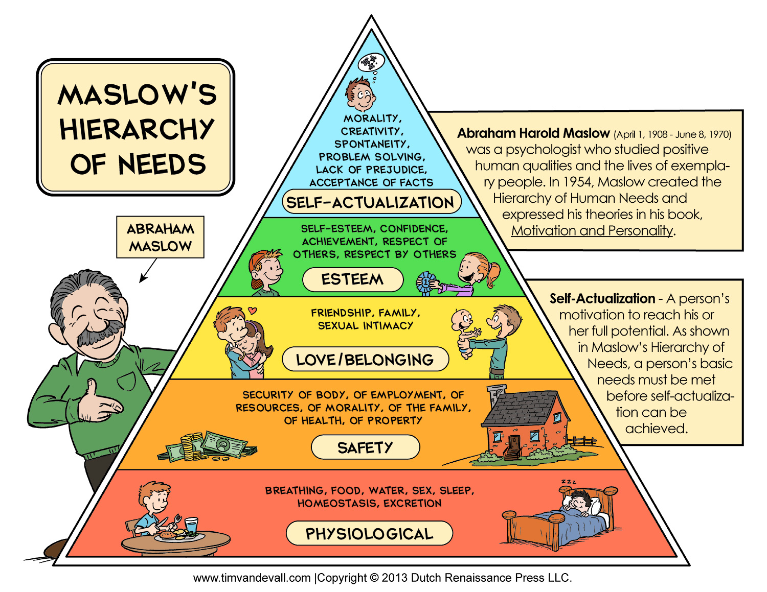

Slide 10
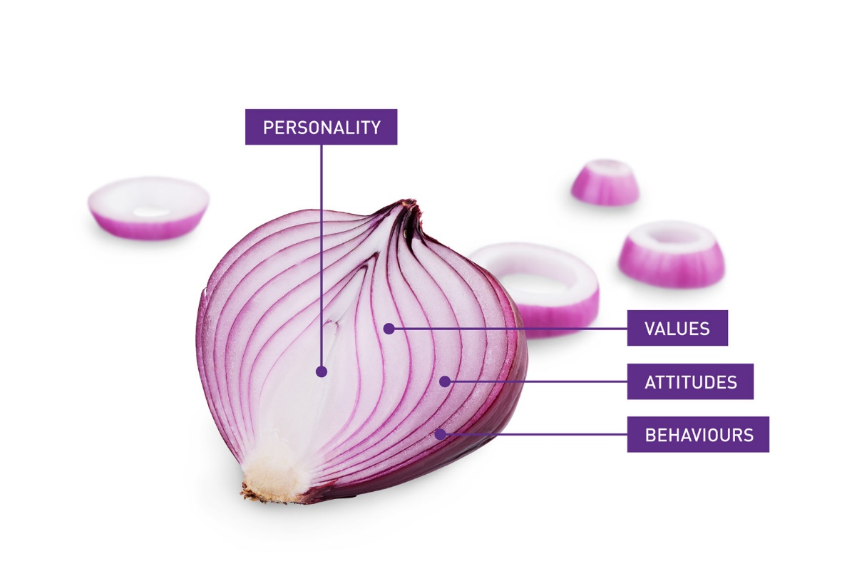
Social Penetration Theory
The social penetration theory, which describes how we move from superficial talk to intimate and revealing talk (Altman, I. and Taylor, D., 1973).
“Onion model”: we see how we start out on superficial level, but as we peel away the layers, we gain knowledge about the other person that encompasses both breadth and depth.

Slide 11
3. Speaking Ethically and Avoiding Fallacies
Fairness
Freedom
Ethics
Manipulation
Deception
Bias
Bribery

Slide 12
Eleven Points for Speaking Ethically
DO NOT:
Use false, fabricated, misrepresented, distorted or irrelevant evidence to support arguments or claims.
Intentionally use unsupported, misleading, or illogical reasoning.
Represent yourself as informed or an “expert” on a subject when you are not.
Use irrelevant appeals to divert attention from the issue at hand.
Ask your audience to link your idea or proposal to emotion-laden values, motives, or goals to which it is actually not related.

Slide 13
Eleven Points for Speaking Ethically
DO NOT:
Deceive your audience by concealing your real purpose, by concealing self-interest, by concealing the group you represent, or by concealing your position as an advocate of a viewpoint.
Distort, hide, or misrepresent the number, scope, intensity, or undesirable features of consequences or effects.
Use “emotional appeals” that lack a supporting basis of evidence or reasoning.
Oversimplify complex, gradation-laden situations into simplistic, two-valued, either-or, polar views or choices.
Pretend certainty where tentativeness and degrees of probability would be more accurate.
Advocate something which you yourself do not believe in.

Slide 14
4. Elevator Speech
An elevator speech is a presentation that persuades the listener in less than thirty seconds, or around a hundred words.
It takes its name from the idea that in a short elevator ride (of perhaps ten floors), carefully chosen words can make a difference.

Slide 15
Creating an Elevator Speech
What is the topic, product or service?
Who are you?
Who is the target market? (if applicable)
What is the revenue model? (if applicable)
What or who is the competition and what are your advantages?

Slide 16
Parts of an Elevator Speech
Speech Component | Adapted to Elevator Speech
Attention Statement | Hook + information about you
Introduction | What you offer
Body | Benefits; what’s in it for the listener
Conclusion | Example that sums it up
Residual Message | Call for action

Slide 17
Example:
1. How are you doing?
2. Great! Glad you asked. I’m with (X Company) and we just received this new (product x)—it is amazing. It beats the competition hands down for a third of the price. Smaller, faster, and less expensive make it a winner. It’s already a sales leader. Hey, if you know anyone who might be interested, call me! (Hands business card to the listener as visual aid)

Slide 18
Activity
Prepare an elevator speech to introduce yourself and your plans after graduation (no more than 1 minutes)
and present to the class.
You have 7 minutes for preparation
(list out key points that you want to convey and impress others)

Slide 19
Key Takeaway
Persuasion is the act of presenting arguments for change, while motivation involves the force to bring about change. The concept of measurable gain assesses audience response to a persuasive message.
We are motivated to communicate in order to gain information, get to know one another, better understand our situation or context, come to know ourselves and our role or identity, and meet our fundamental interpersonal needs.
Speaking to persuade should not involve manipulation, coercion, false logic, or other unethical techniques.
You often don’t know when opportunity to inform or persuade will present itself, but with an elevator speech, you are prepared!

Slide 20
Exercises
Select an online advertisement that you find particularly effective or ineffective. Why does it succeed, or fail, in persuading you to want to buy the advertised product? Discuss your ideas with your classmates.
Consider your life in relation to Maslow’s hierarchy of needs. To what degree do you feel you have attained the different levels in the hierarchy? Two or three years ago, were you at the same level where you currently are, or has your position in the hierarchy changed? In what ways do you expect it to change in the future? Discuss your thoughts with your classmates.

Slide 21


